Slide 1
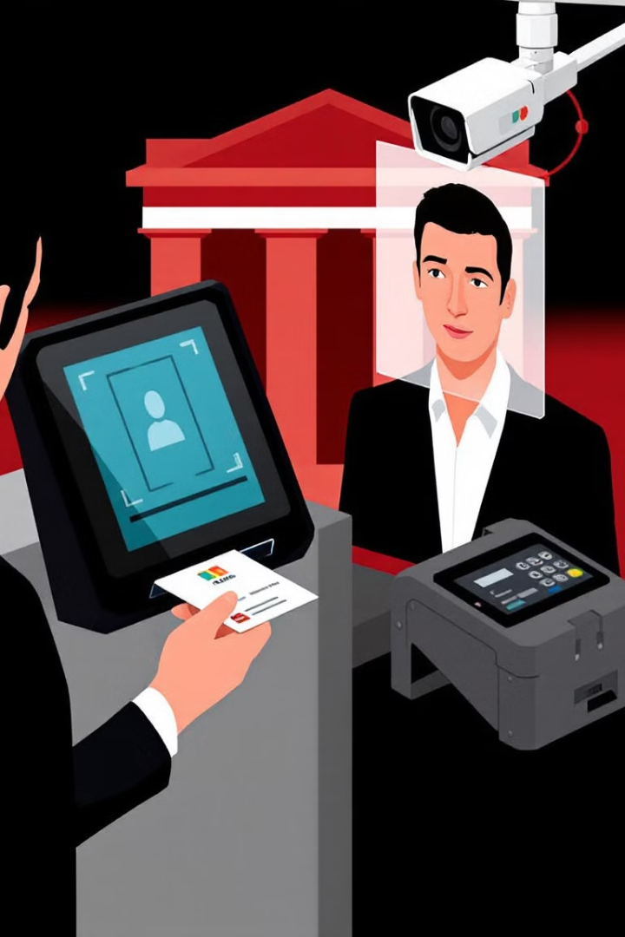

Objective
To design, develop, and implement a robust, scalable, and globally compatible Optical Character Recognition (OCR) and facial biometrics for XYZ Bank.
by Unknown

Slide 2

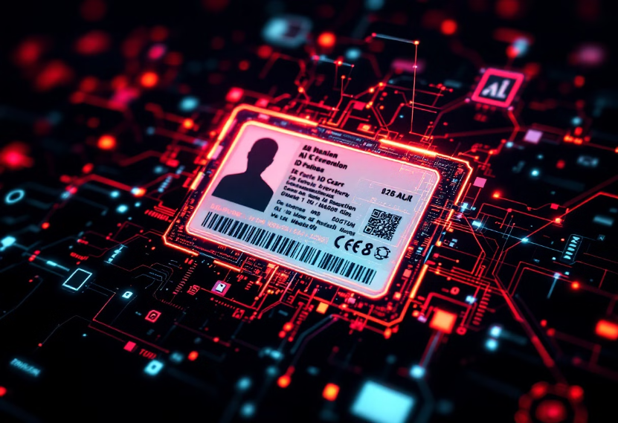
Automatic ID Card Detection & Capture Demo
Manual General Implementation
Custom Trained Model
Our standard approach to ID card detection and capture, providing reliable functionality across a wide range of document types.
Our advanced solution using machine learning to improve accuracy and speed of ID card detection across various lighting conditions and angles.

Slide 3





KPIs Achieved
ID Card Capture/Upload
ID Card Image Integrity
Basic Implementation to Detect and Auto-Capture ID Cards ✅
Image Quality Checks ✅
Custom Trained Model to Detect and Auto-Capture ID Cards ✅
Xerox Validation ✅
Manual ID Card File Upload ✅
Supported Document ✅
Original Template Format Validation ✅
Orientation Validation ✅
Digital Tampering Validation ✅
Selfie Video
Additional Validations
Picture Face Integrity (Spoof Detection) ✅
Age Validation: Minimum Accepted Age ✅
Multiple Faces Detection ✅
Facial Biometrics: Face Detection ✅
Face not clearly visible/bad lighting Detection ✅
Facial Biometrics: Face Verification ✅
Best Frame Extraction ✅

Slide 4




Yet to Achieve
Colour Picture
Enhanced color validation ❌
Font
Font verification and analysis ❌

